Slide 1



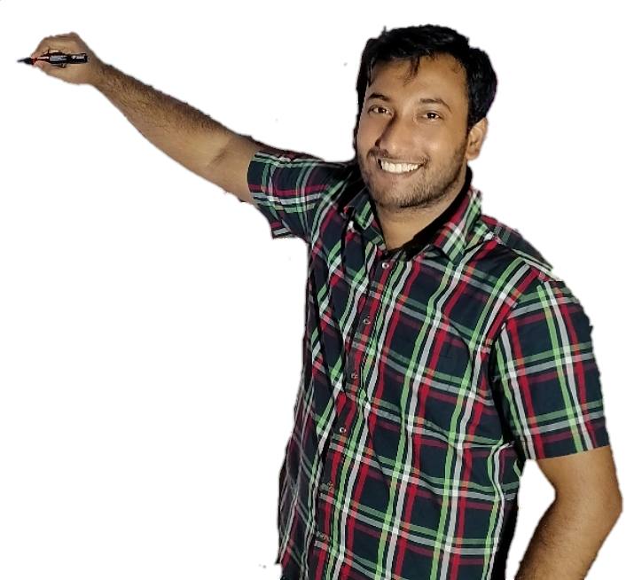
Week-9 (Discussion)
19th Sept, 2025
Computer Vision
Prof. Jayanta Mukhopadhyay
Professor
Computer Science and Engineering Department
IIT Kharagpur
Ayan Paul
PMRF Research Scholar
IIT Kharagpur

Slide 2
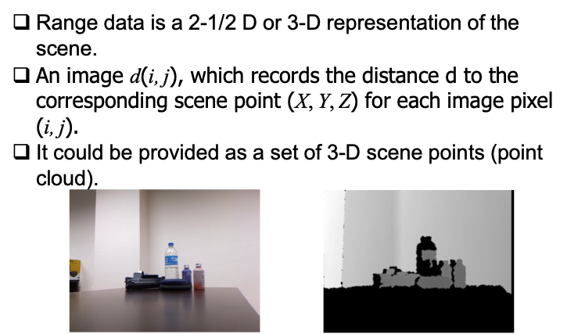
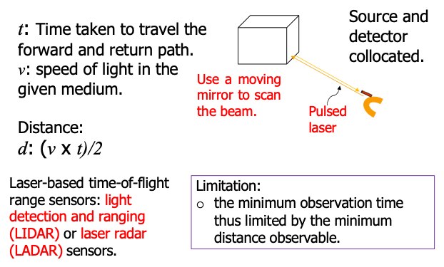
Range data
Range Imaging Techniques
Passive imaging. Extracts depth information without projecting any energy into the scene.
Stereo imaging
Active range sensing. Actively projects energy (light, laser, IR, etc.) onto the scene and measures its reflection to compute depth.
Time-of-flight sensors
Triangulation-based sensors
Structured Light
Time-of-Flight Range Sensors
A range image is a special type of image in which each pixel value does not represent brightness or color, but rather the distance (range) from the sensor to the surface of an object in the scene.
In other words:
A conventional image → pixel = intensity/color.
A range image → pixel = depth (distance from viewpoint).

Slide 3
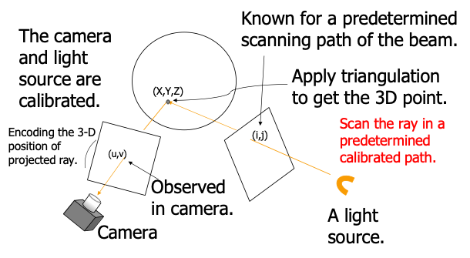
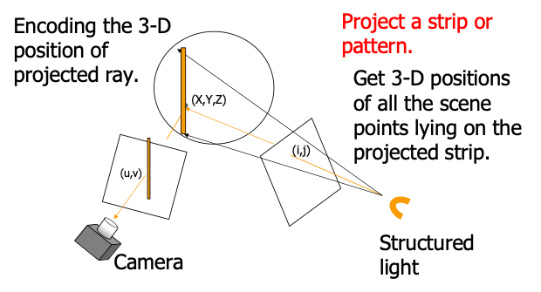
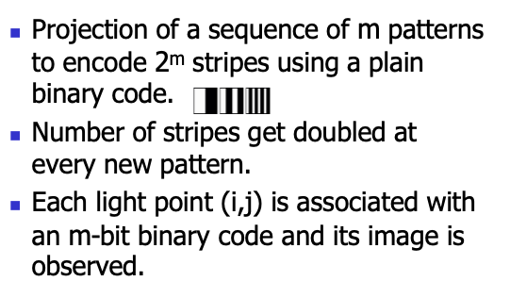
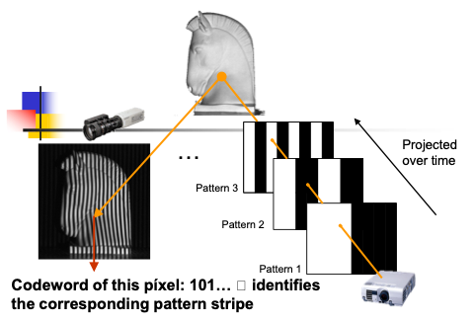
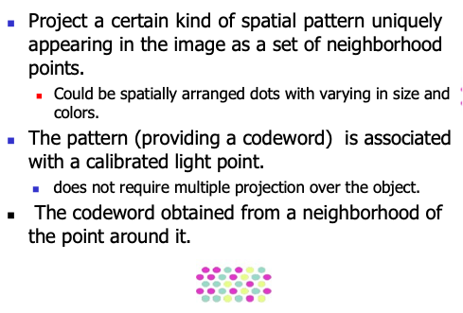
Triangulation based Sensors
Structured Light
Space Encoding
Binary Coding
Spatial Codification

Slide 4
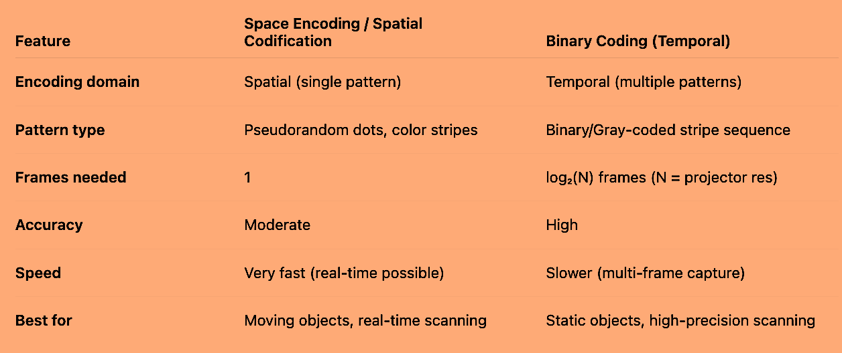
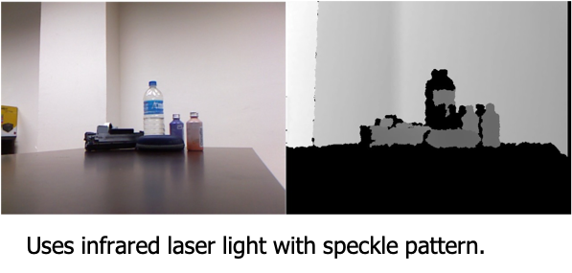
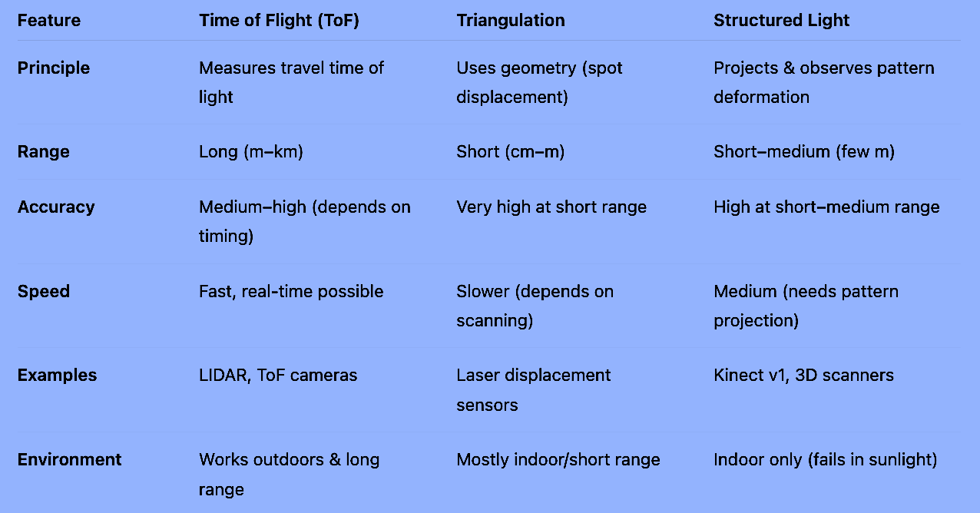
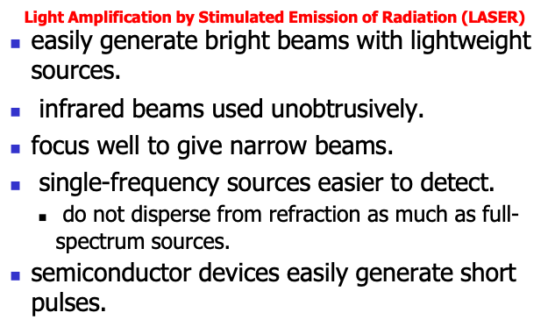
Coding Strategies Comparison
RGBD images from Microsoft Kinect
Active Range Sensing Comparison
Why Lasers?

Slide 5
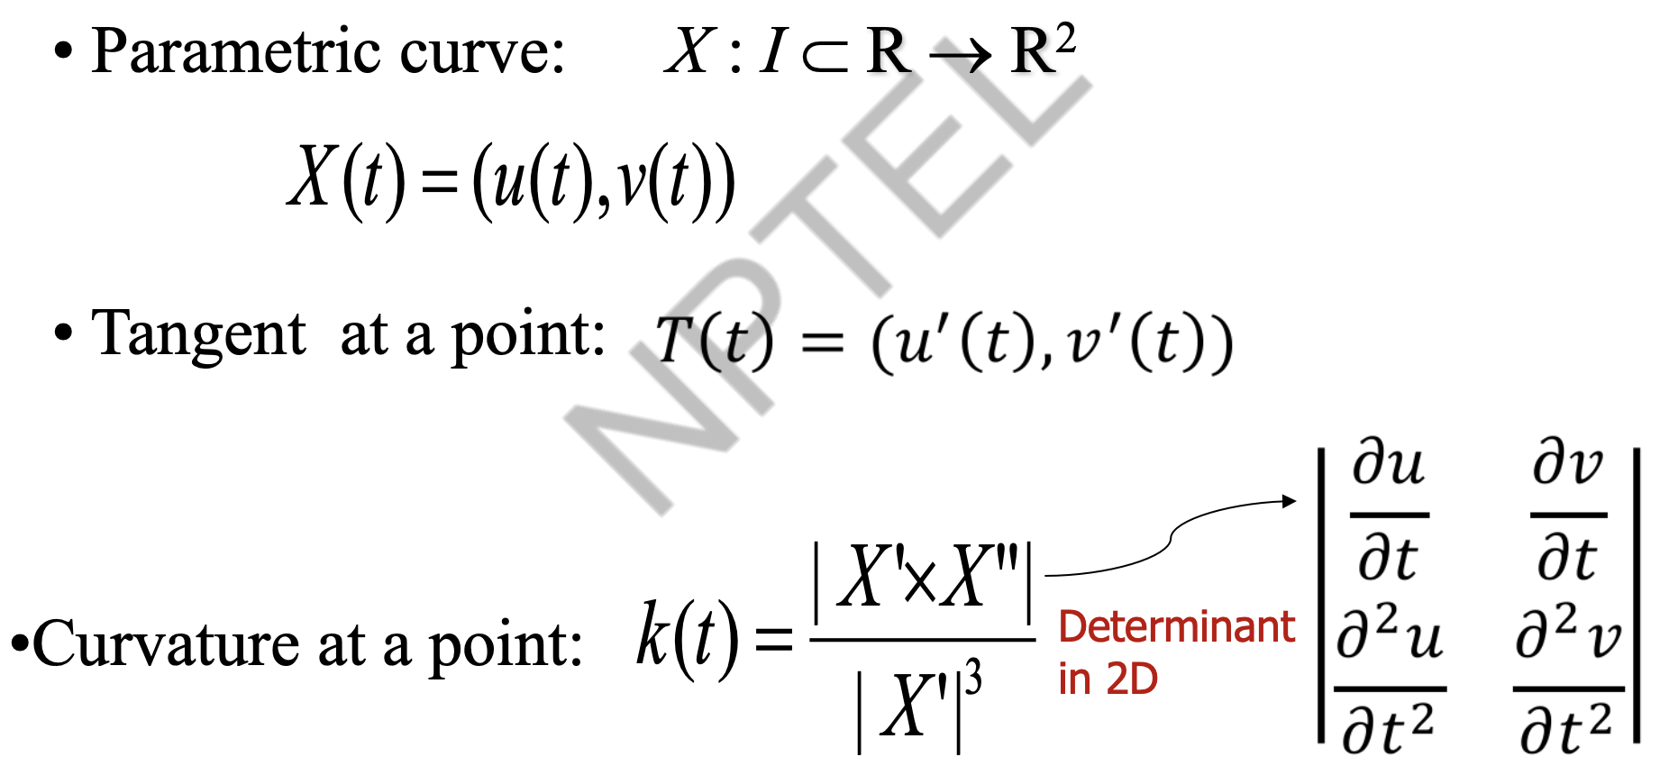
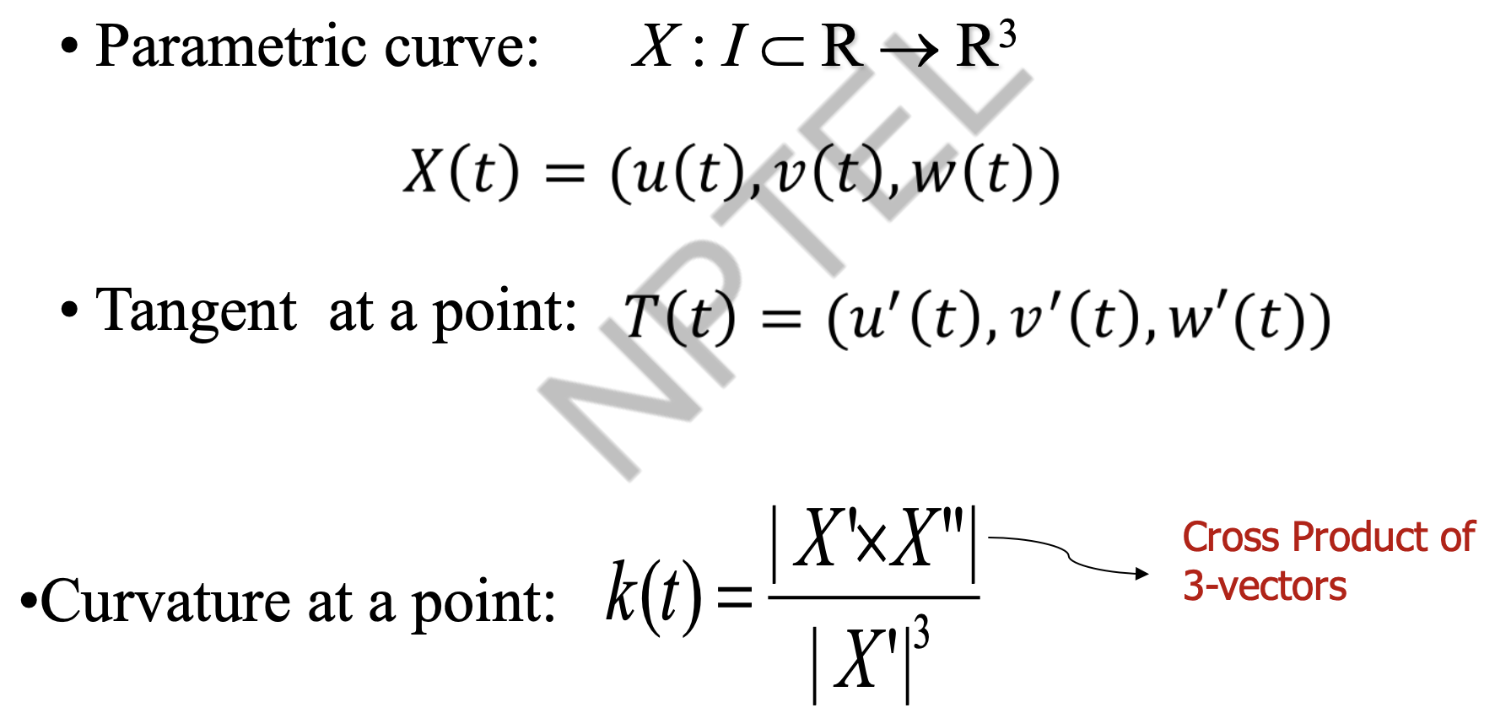
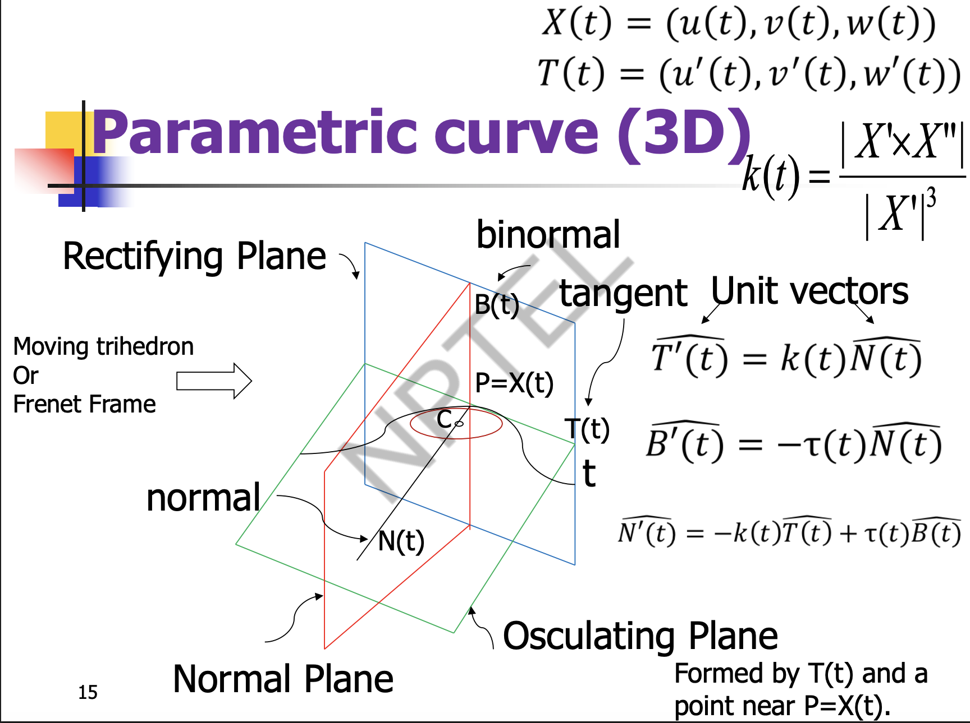
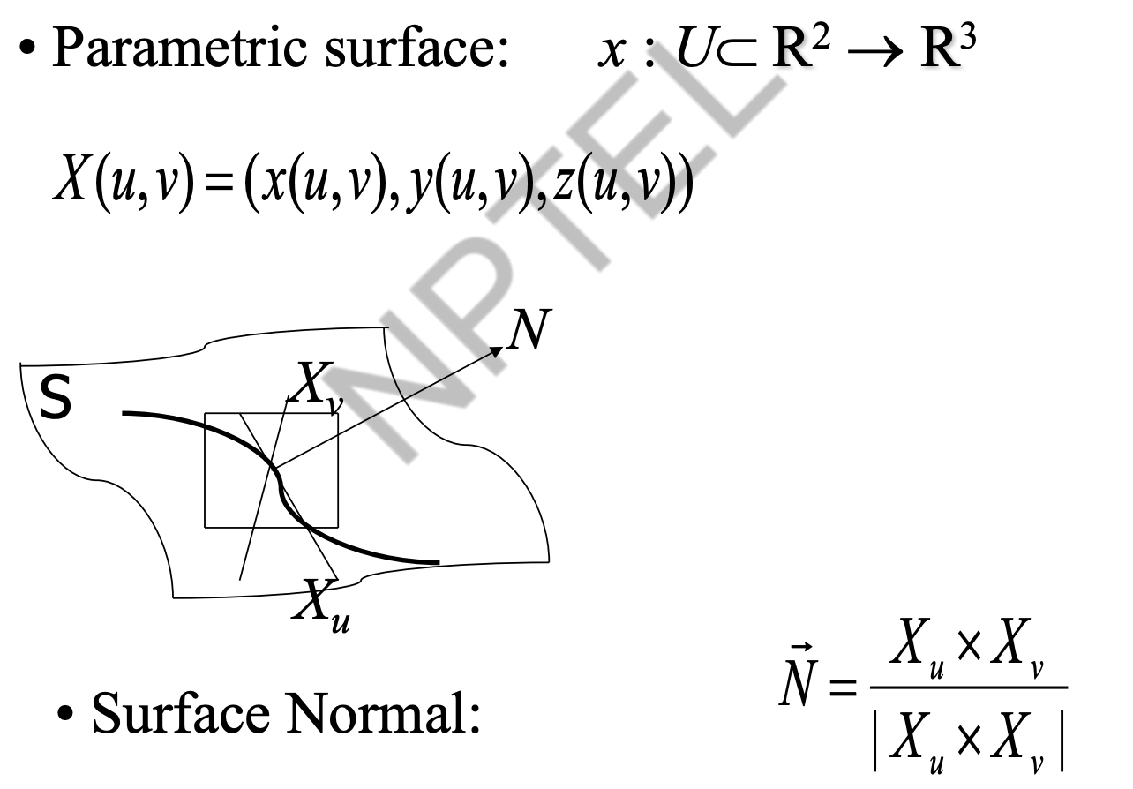
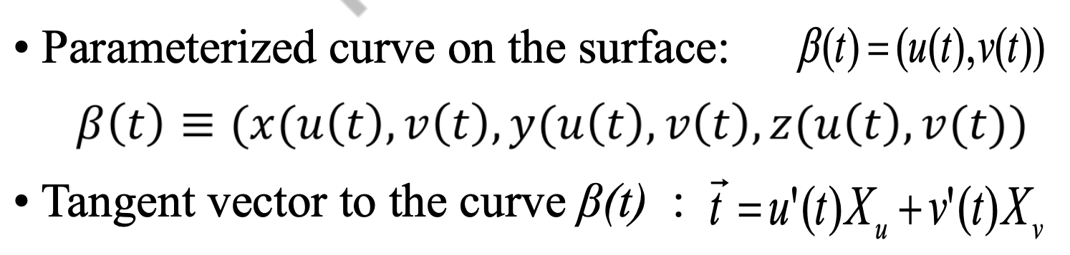
Parametric curve (2D)
Parametric curve (3D)
Parametric surfaces

Slide 6
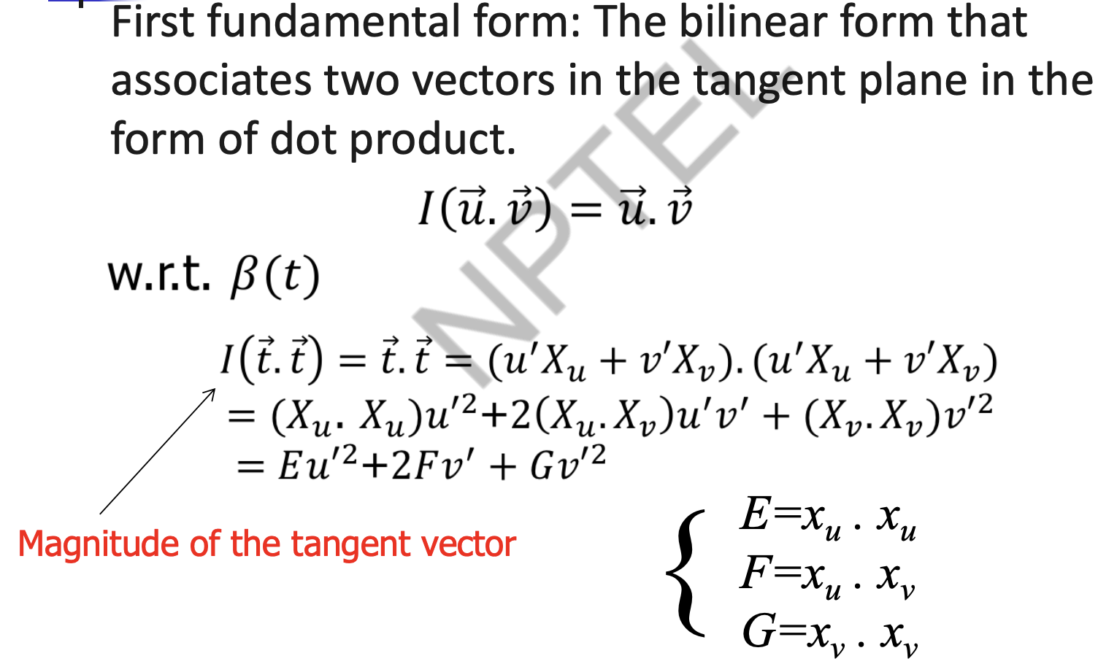
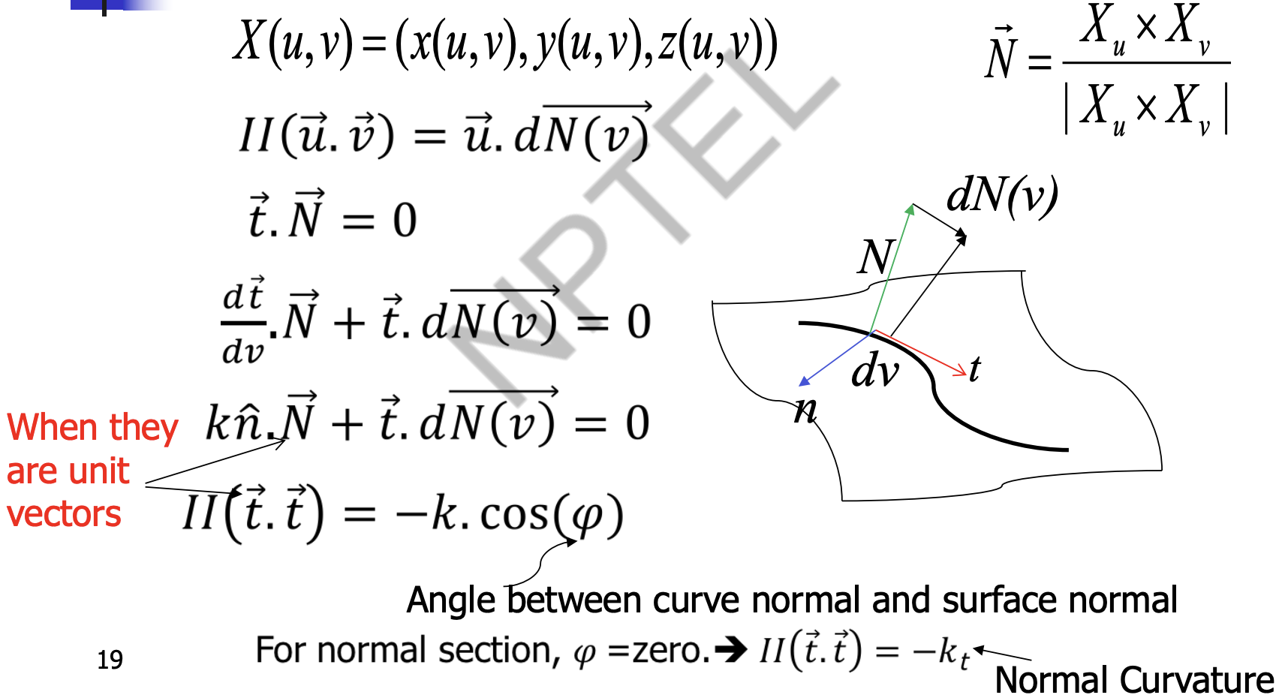
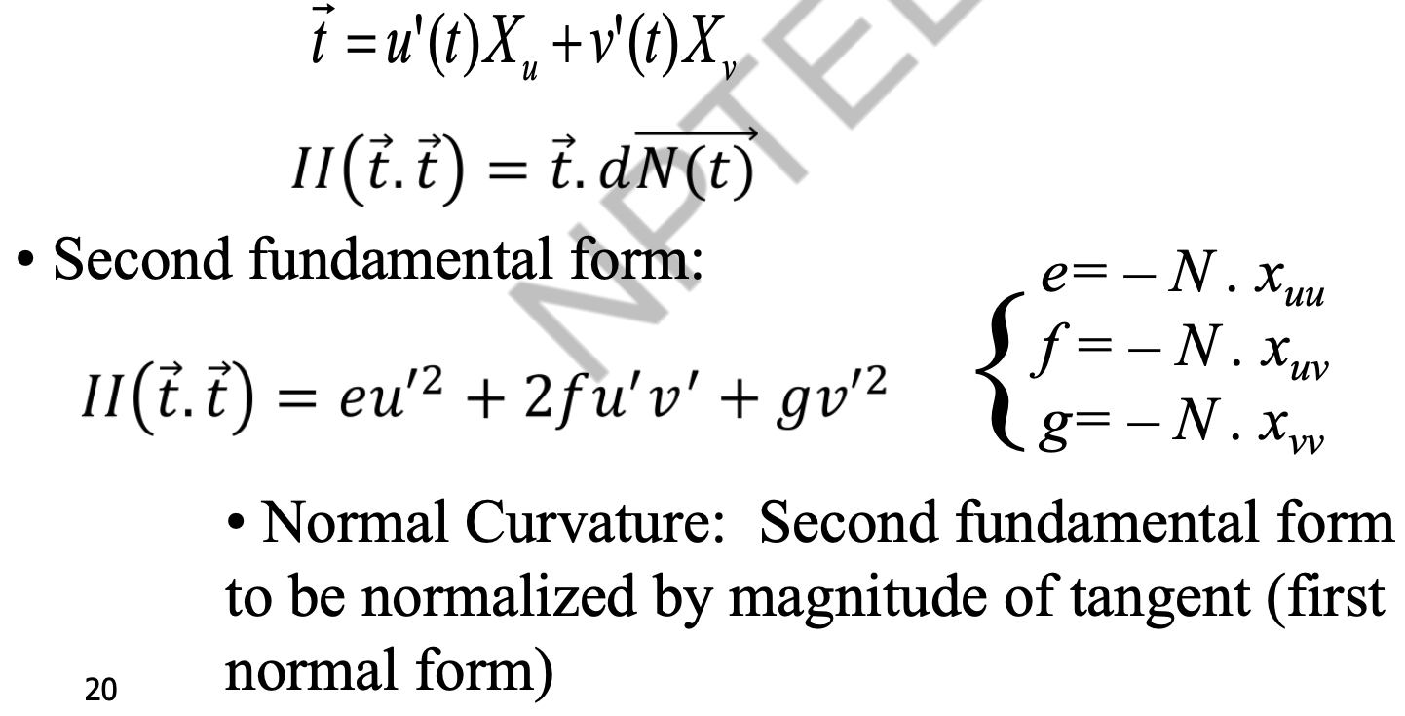
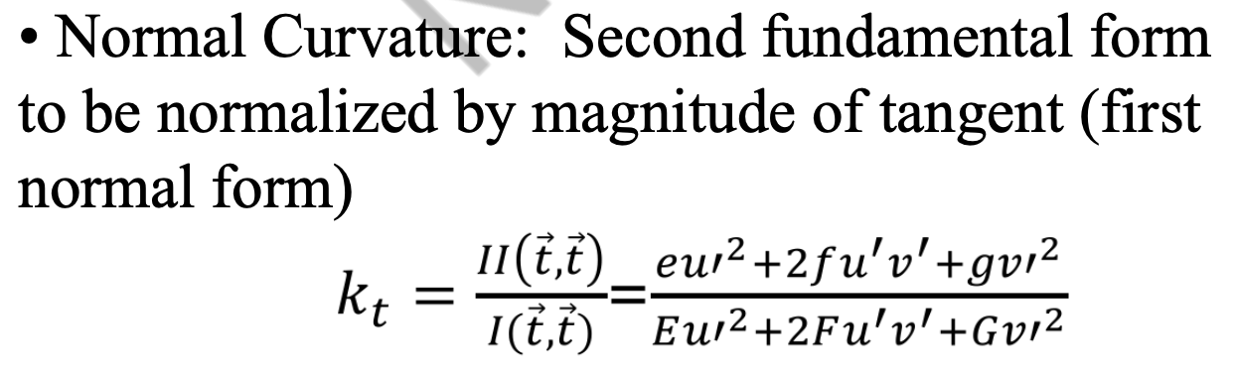
First Fundamental Form
Second Fundamental Form
Normal Curvature

Slide 7
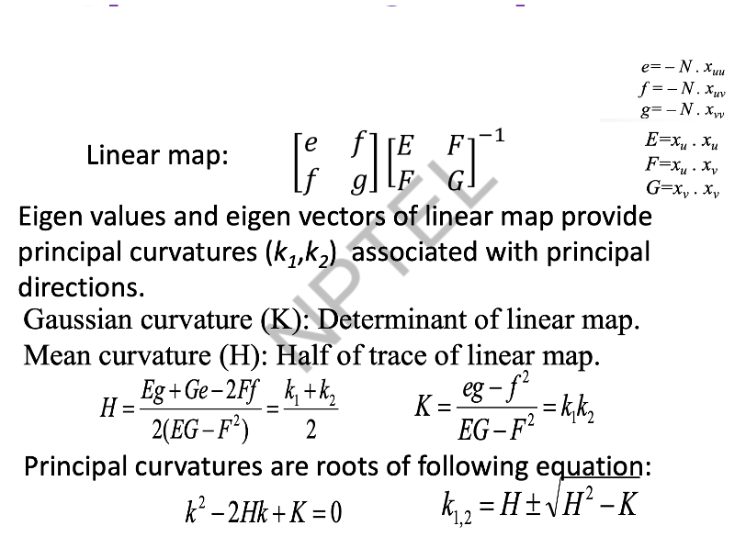
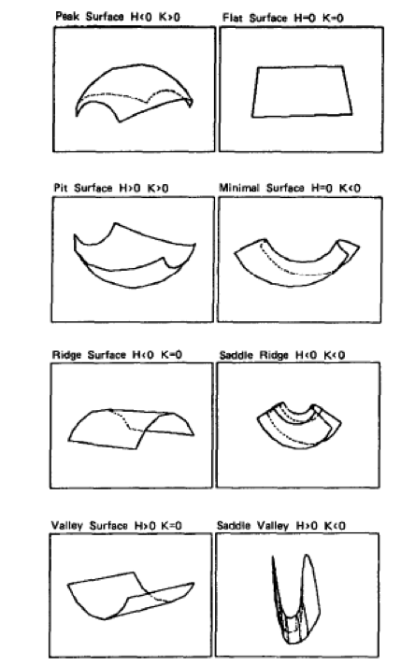
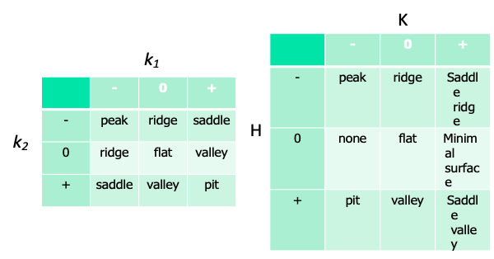
Eight visible Surface types from signs of curvatures
Linear map, Gaussian and Mean curvatures

Slide 8
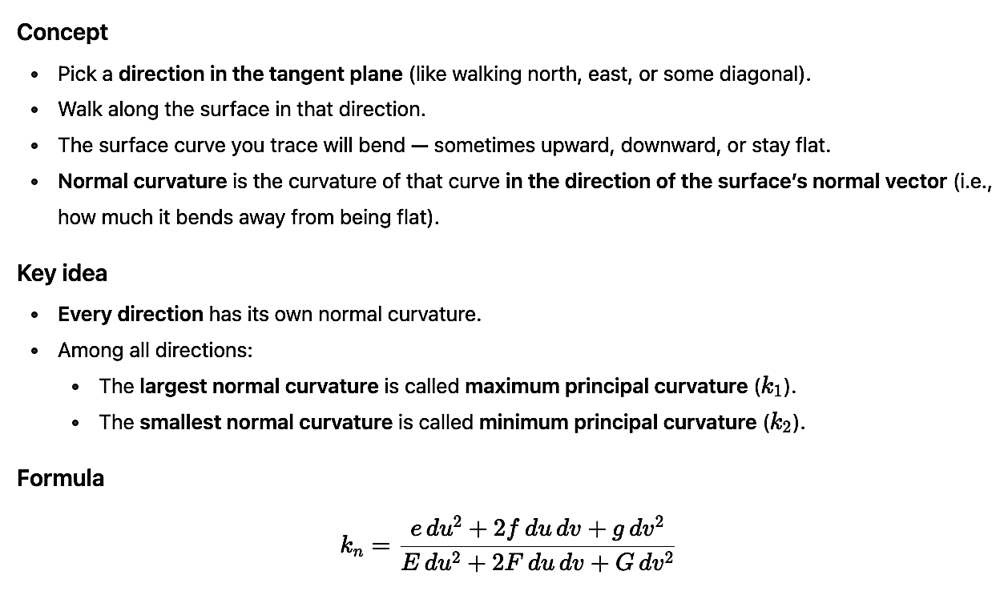
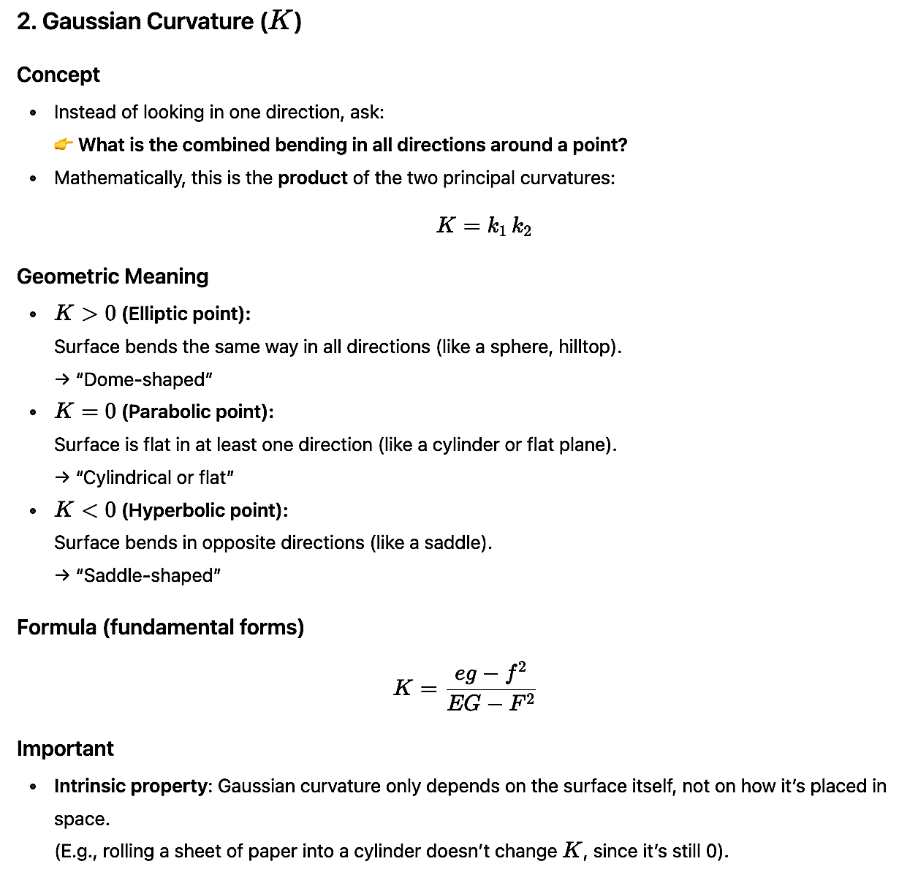
Understanding curvatures
When we talk about curvature, we’re asking: How does this surface bend around you?
Normal Curvature
Gaussian Curvature

Slide 9
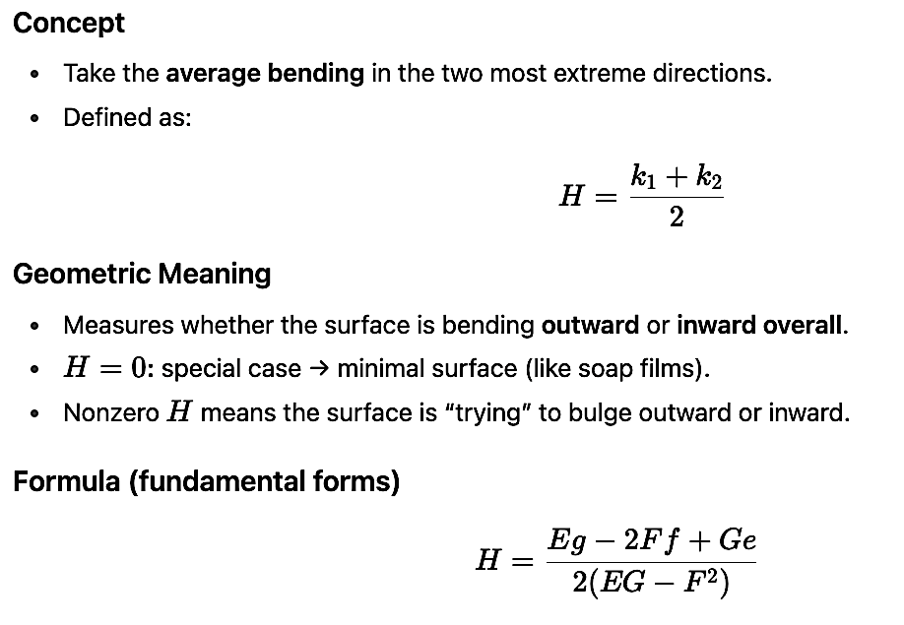
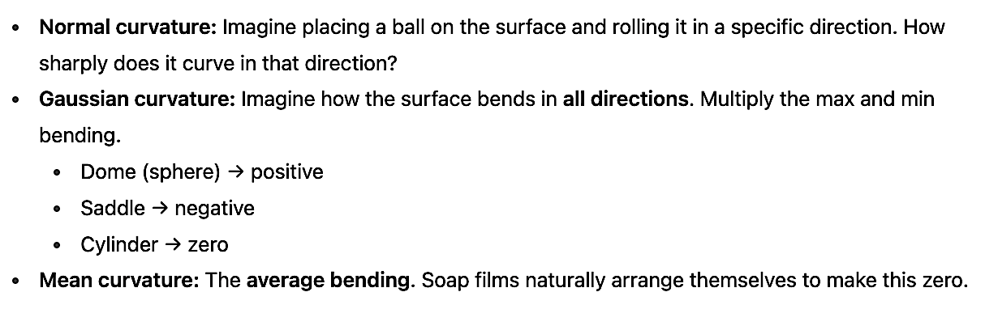
Mean Curvature
Analogy for Curvatures

Slide 10
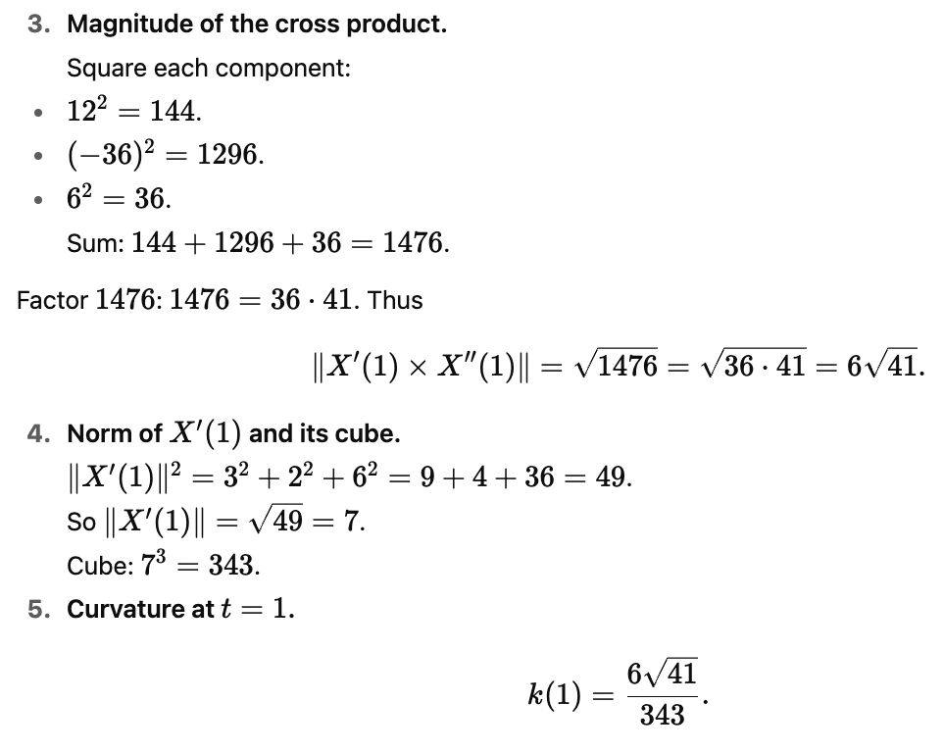
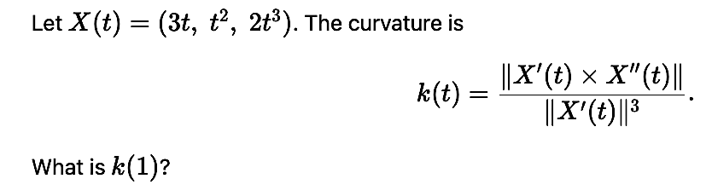
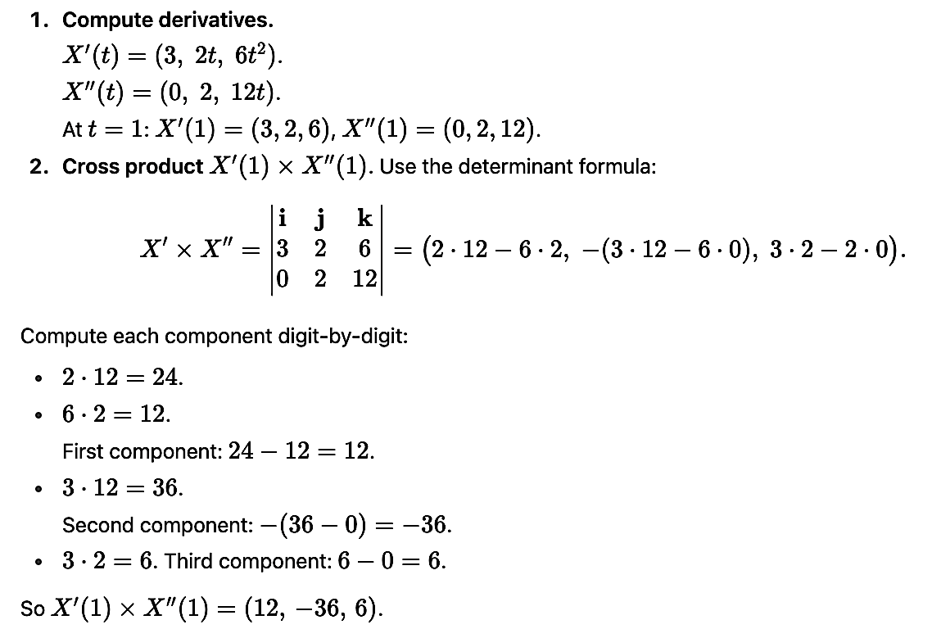
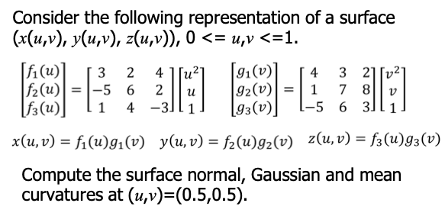
Exercise - 1
Solution
Exercise - 2

Slide 11
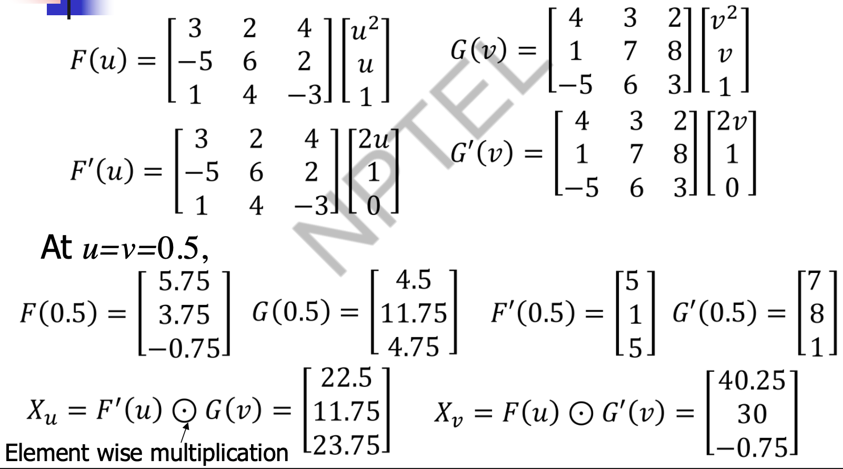
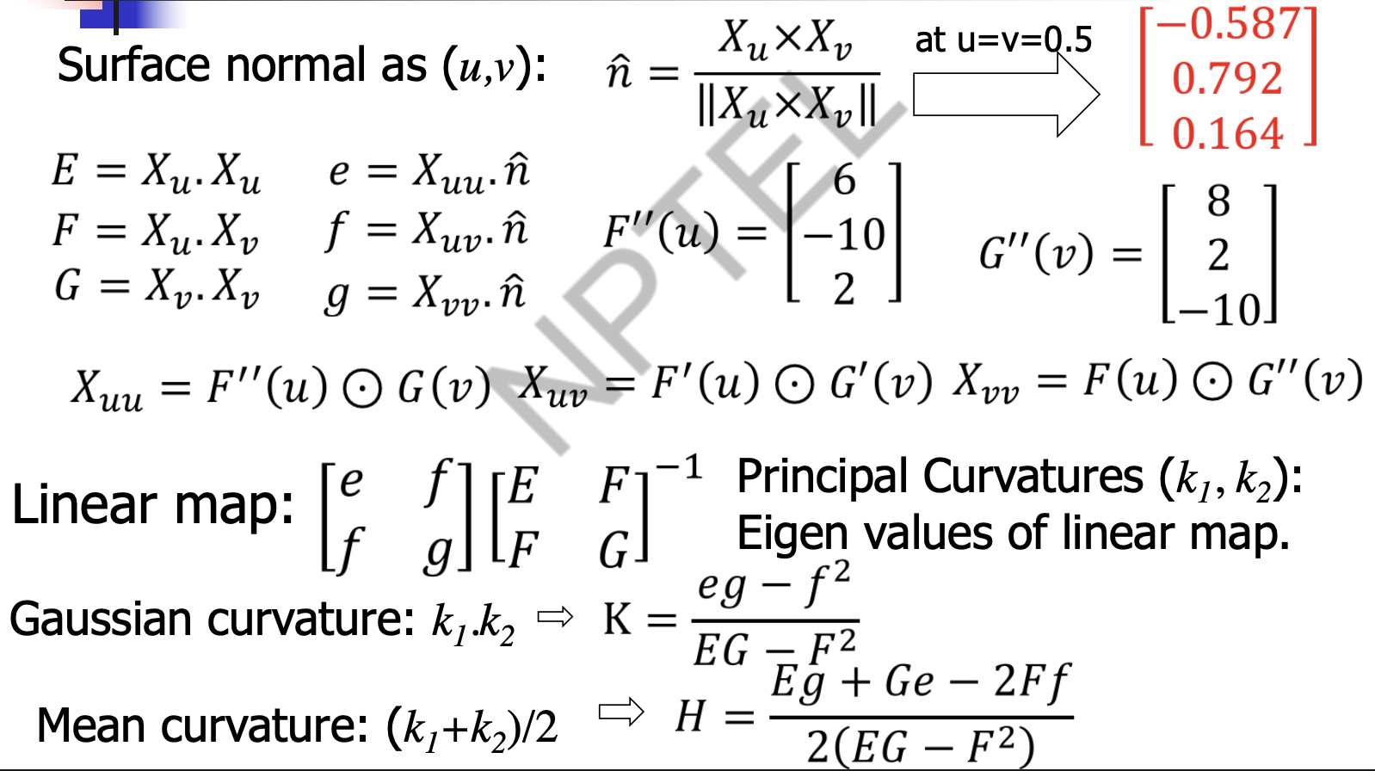
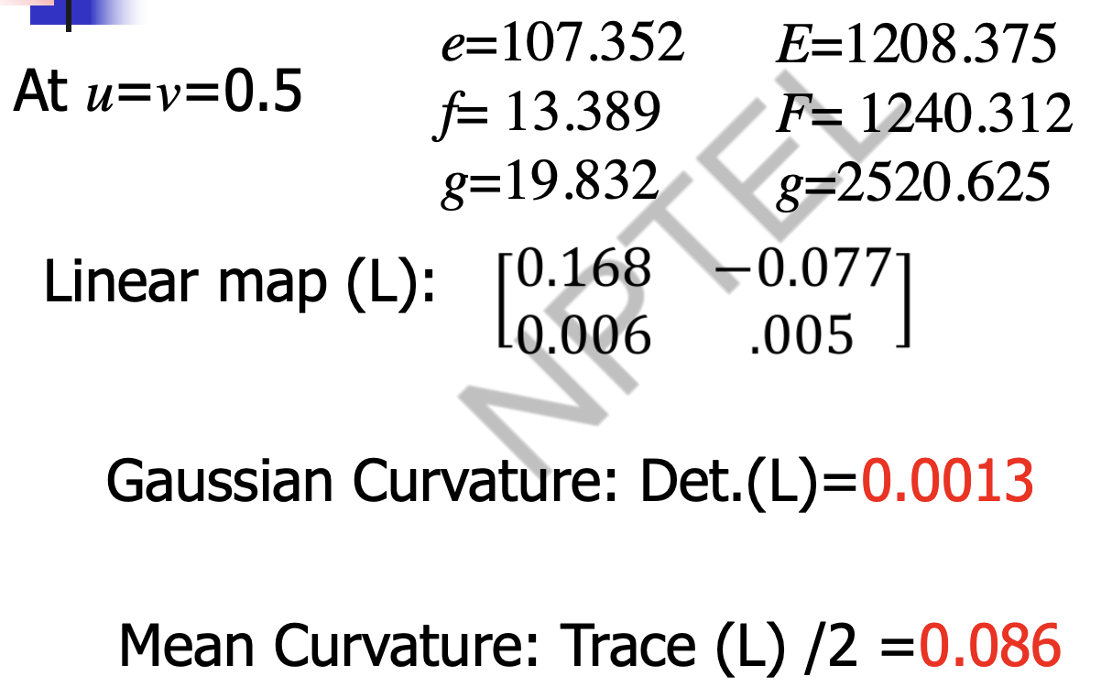
Solution

Slide 12
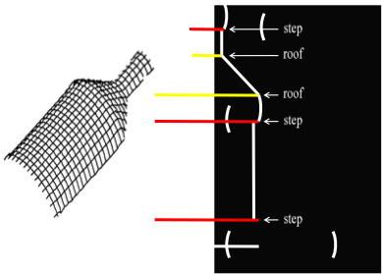
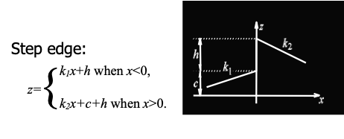
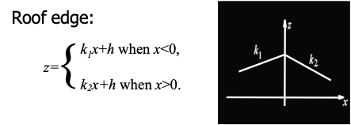
Step and Roof Edges in Range Images
In range images, discontinuities often occur. Two important types of discontinuities (or edges) are step edges and roof edges:
Step Edges in Range Images
Definition: A step edge occurs when there is a sudden change in depth (range value) between adjacent pixels.
Interpretation: This happens at object boundaries or occluding edges where one object ends and another (or the background) begins.
Appearance in range images: A sharp jump in pixel values.
Example: Edge between a box and the wall behind it.
Roof Edges in Range Images
Definition: A roof edge occurs when the depth values change gradually to a peak or ridge and then decrease.
Interpretation: This represents a surface discontinuity due to curvature, often at ridges or corners of an object where two faces meet smoothly.
Appearance in range images: A line of local maxima/minima in depth gradient.
Example: The edge along the ridge of a roof, or the sharp fold on the corner of a cube.
Feature | Step Edge | Roof Edge
Depth change | Abrupt jump | Gradual slope with a peak
Occurs at | Object boundary / occlusion | Ridge, crease, or fold on a surface
Gradient | Very high, sudden | High at the peak, zero at the ridge center

Slide 13
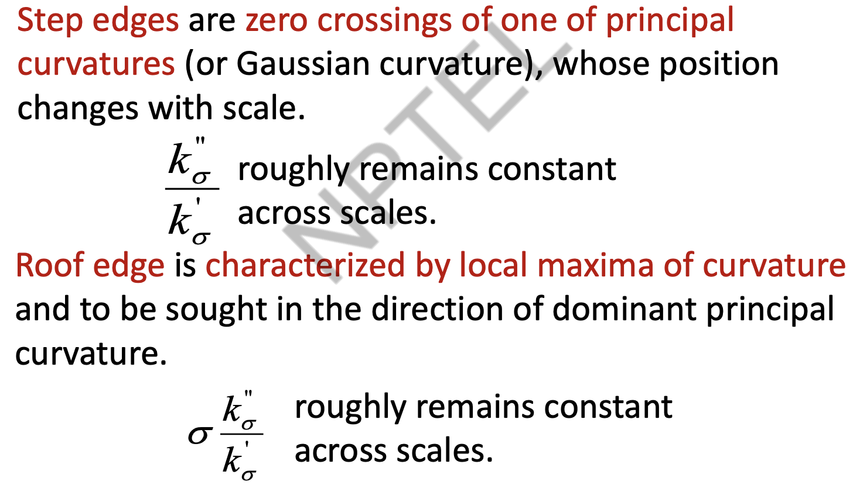
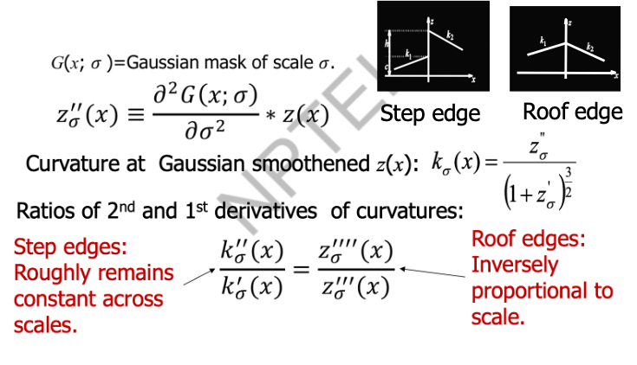
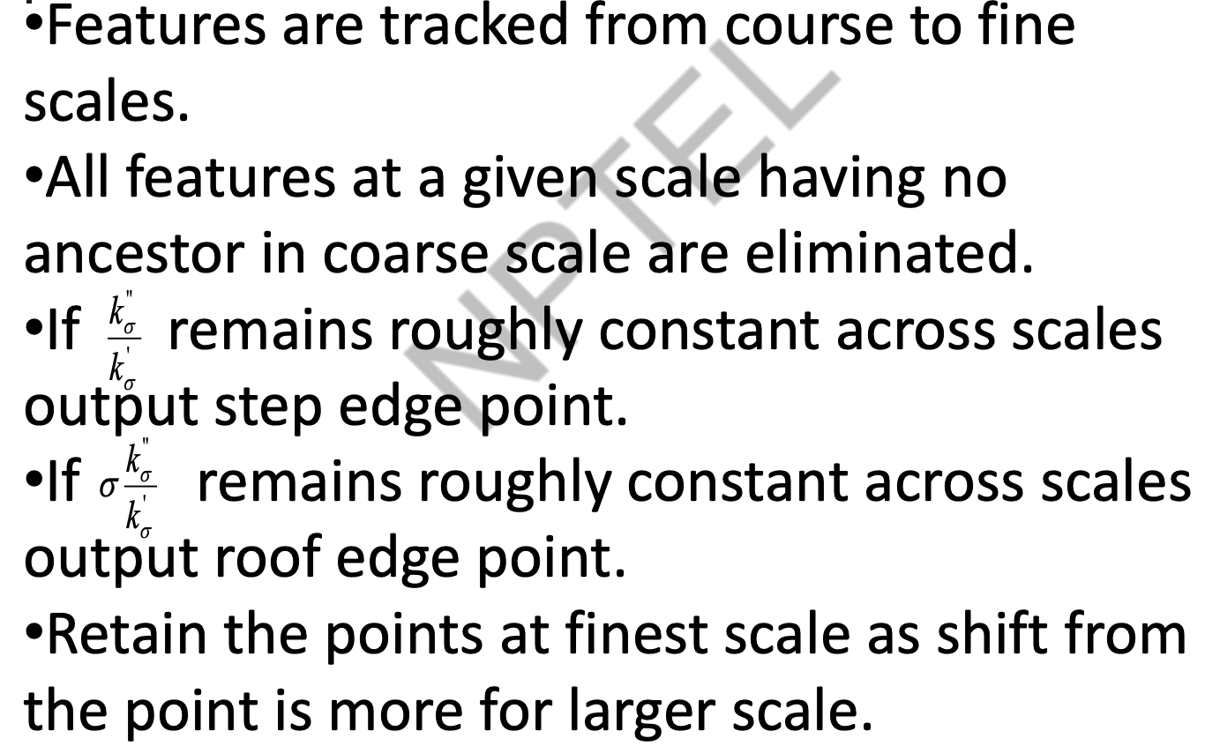
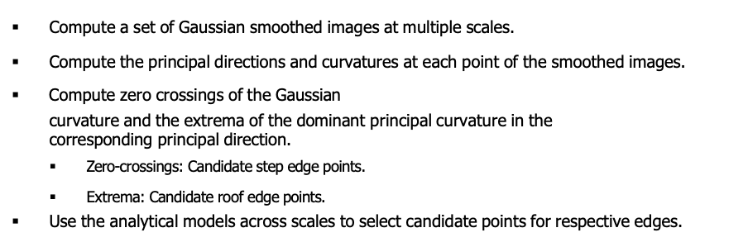
Characterizing Edges
Multi-scale edge tracking
The Algorithm

Slide 14
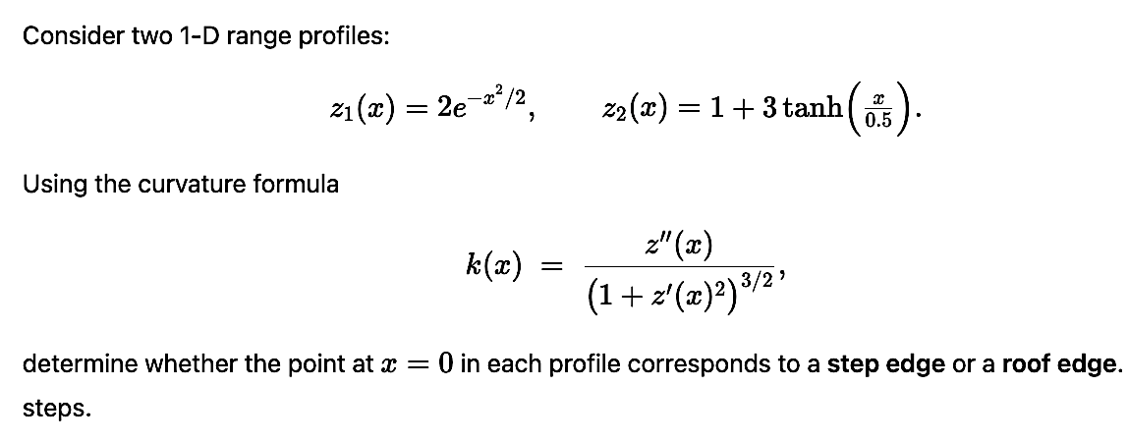
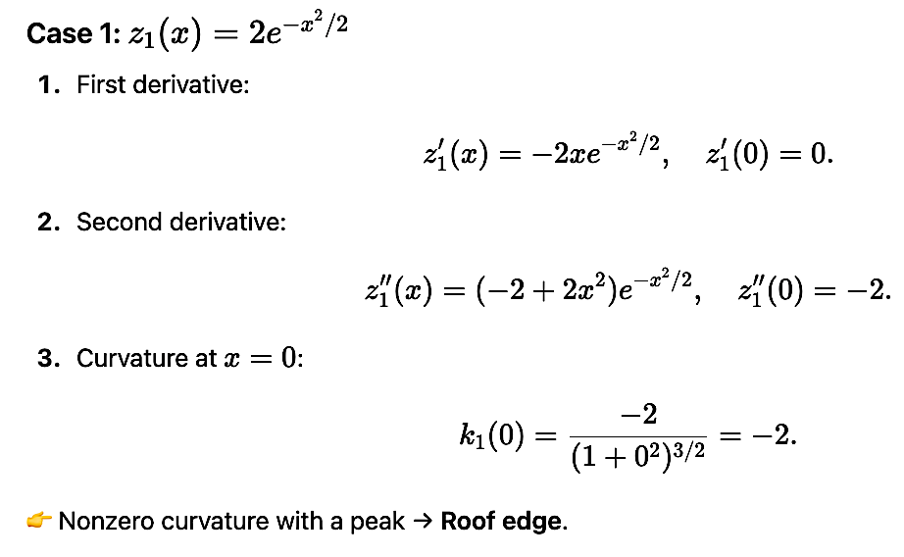
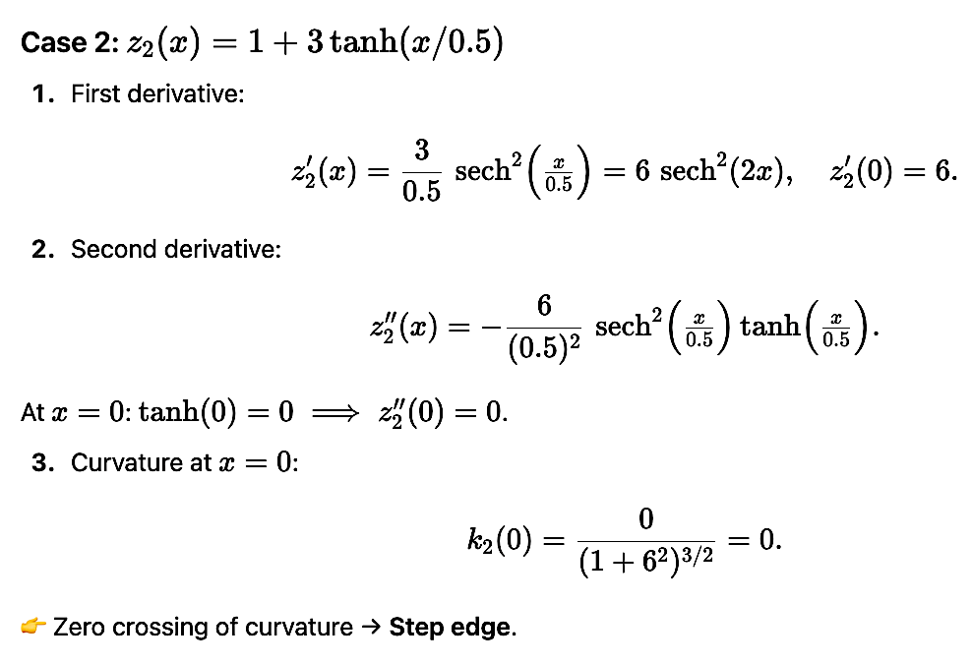
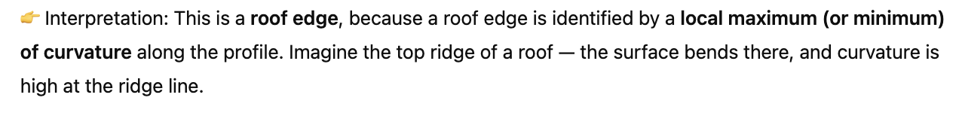
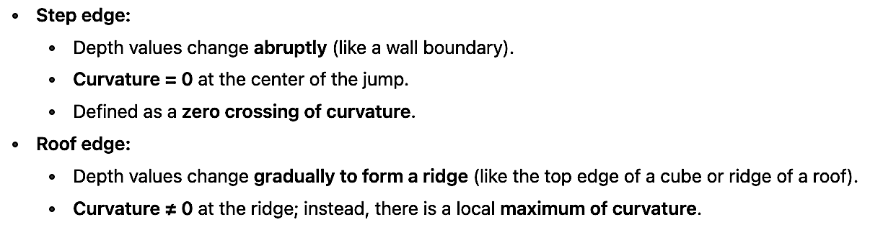
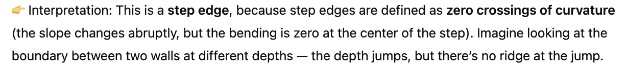
Exercise - 3
Solution

Slide 15
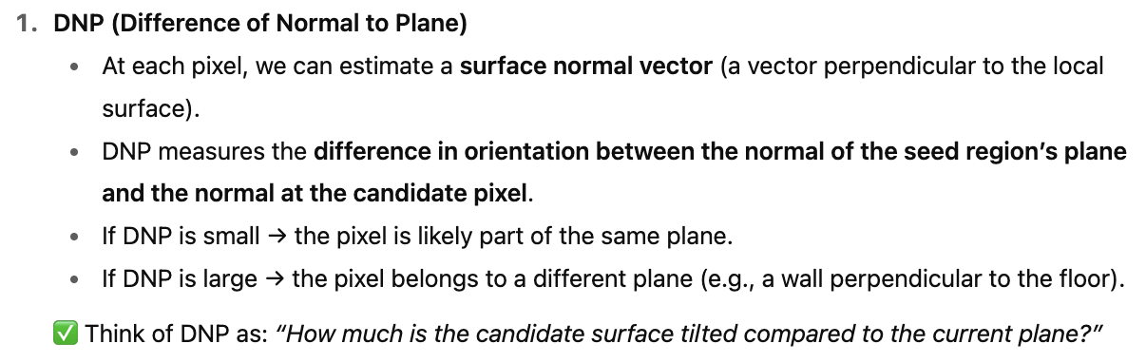
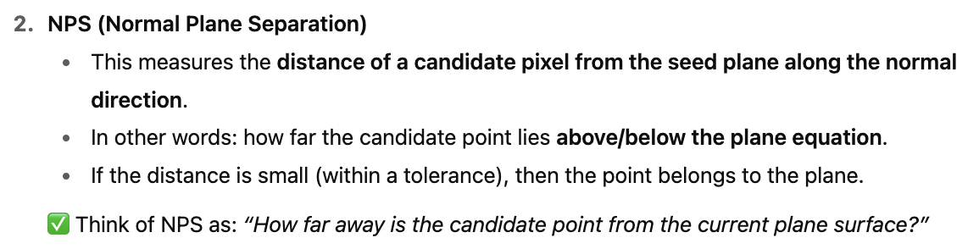



Segmentation into Planes via Region Growing
Range image segmentation: Morphological approach
When we have a range image (depth map), surfaces of real-world objects often form planar regions (like walls, floors, table surfaces). The region growing method is a segmentation approach where:
We pick a seed pixel (starting point).
We check its neighborhood pixels.
If the neighbors have similar plane properties (i.e., they belong to the same plane), we add them to the region.
The process continues until no more pixels can be added.
So, it “grows” a region corresponding to one plane in the scene. This is useful in 3D reconstruction, robotics, and object recognition.

Slide 16





3-D Neighborhood of a point p
The Algorithm

Slide 17


Registration of range data
Registration of range data is the process of aligning two or more range images (or 3D point clouds) of the same object or scene into a common coordinate system.
A range image (or point cloud) is captured from a specific viewpoint (e.g., by a laser scanner, LiDAR, or depth camera).
Since one viewpoint only covers part of the object, we need to combine multiple views to reconstruct the whole 3D shape.
Registration finds the rigid transformation (rotation + translation) that best aligns these partial scans.
Steps in Registration

Slide 18




Estimation of rigid body transformation
The Iterative Closest Point (ICP) Registration Algorithm
Iteratively finds closest points between two scans and updates transformation until convergence.

Slide 19
Topics on which Week 9 Assignment Questions are based
Different types of range sensors - Stereo imaging, Time of flight, Triangulation through scanning beams, Structured light
Differential geometry in extracting local features of a pixel (point) in a range image - Surface normal, Principal Curvatures, Gaussian curvature, mean curvature.
Characterization of step and roof edges.
Segmenting range images into planar patches.
Registration of range images.

Slide 20


QUESTION 1
SOLUTION 1
CORRECT ANSWER 1
a)

Slide 21

QUESTION 2
Which of the following is true about Microsoft kinect sensor:
a) Uses infrared laser light with speckle pattern
b) If a point is at a higher depth from the sensor, it looks more blurry
c) Uses the principle of structured light
d) All of the above
SOLUTION 2
CORRECT ANSWER 2
d)

Slide 22




QUESTION 3
Consider the coefficients of first fundamental form are given by E = 5, F = 1, G = 3 and the coefficients of second fundamental form as e = 3, f = 7, g = 3. Compute the Gaussian curvature K.
a) −23/7
b) −20/7
c) −8/8
d) 23/4
SOLUTION 3
CORRECT ANSWER 3
b)

Slide 23

QUESTION 4
Choose the correct option:
a) Eight illumination levels are used in binary coding
b) n patterns must be projected in order to encode 2n stripes in space encoding
c) Every encoded point in binary encoding is identified by the sequence of occurrences that it receives
d) Every decoded point in space encoding is identified by the sequence of intensities that it receives)
SOLUTION 4
CORRECT ANSWER 4
b), c)

Slide 24



QUESTION 5
SOLUTION 5
CORRECT ANSWER 5
d)

Slide 25


QUESTION 6
Which of the following statements are not true for detection of edges in a range image?
a) Roof edge points are detected from zero crossings of Gaussian curvature.
b) Step edge points are detected from zero crossings of Gaussian curvature.
c) Step edge points are detected by the extrema of dominant principal curvature corresponding to its direction.
d) Roof edge points are detected by the extrema of dominant principal curvature corresponding to its direction.
SOLUTION 6
.
CORRECT ANSWER 6
a), c)

Slide 26


QUESTION 7
Consider the coefficients of first fundamental form are given by E = 2, F = 3, G = 7 and the coefficients of second fundamental form as e = 4, f = 0, g = 3. Compute the mean curvature H. (Answer upto 2 decimal places)
a) 4.25
b) 3.40
c) 3.25
d) 3
SOLUTION 7
CORRECT ANSWER 7
b)

Slide 27

QUESTION 8
Which of the following are examples of active imaging?
a) Time-of-flight sensors
b) Triangulation-based sensors
c) Structured light
d) Stereo imaging.
SOLUTION 8
CORRECT ANSWER 8
a), b), c)

Slide 28

QUESTION 9
Which of the following uses laser radar (LADAR) sensors
a) Time-of-flight sensors
b) Triangulation-based sensors
c) Stereo imaging
d) Structured Light
SOLUTION 9
.
CORRECT ANSWER 9
a)

Slide 29


QUESTION 10
Choose the correct options regarding Digital Neighborhood Planes (DNPs) for a 3D neighborhood of a point p:
a) Number of principal planes are 3
b) Number of diagonal planes are 6
c) Total number of digital neighborhood planes are 9
d) Total number of digital neighborhood planes are 8
SOLUTION 10
CORRECT ANSWER 10
a), b), c)

